Slide 1

Oregon State Legislature
Video Streaming, Recording and Archiving Granicus Partnership/RFP Review
Erin Pardue, Legislative Solutions Specialist
Jesse Wallace, Solutions Engineer

Slide 2





ABOUT
GRANICUS
BY THE NUMBERS
185M+
Citizens Subscriber
1,500+
Government Websites
TRUSTED BY 4,000+ GOVERNMENT
ORGANIZATIONS AROUND THE WORLD
48 of 50
Most Populous U.S. Cities
10
Messages Sent per Second
500%+
Increase in Engagement
5M+
Legislative Files Stored

Slide 3
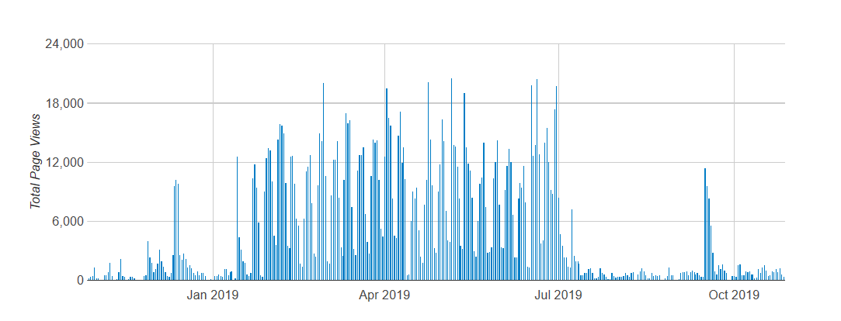
Customer Success Insights
Ensuring a positive customer experience by strengthening adoption
Oregon Legislature in Numbers:
Client since 2012
Unlimited Active meeting bodies
3,000+ Archives in 2019
The Granicus Advantage:
20+ years serving government agencies
Unlimited storage/Secure data centers
Offer SDI encoders & PA’s
Stable platform with full integration
Streaming page views each month 2018-2019:

Slide 4
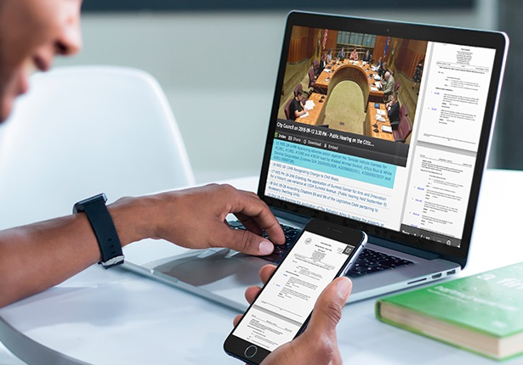
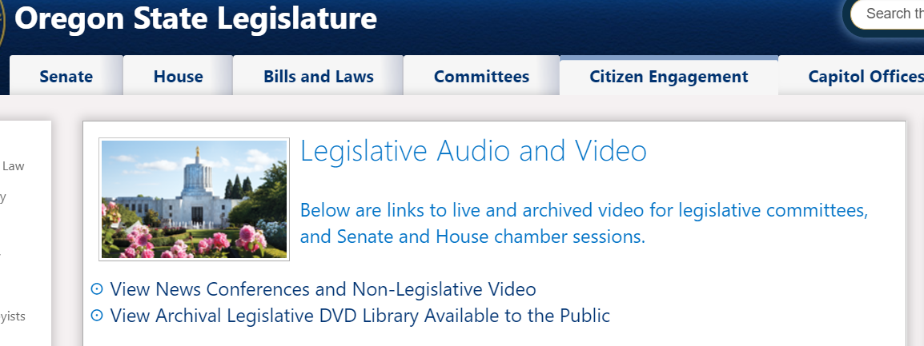
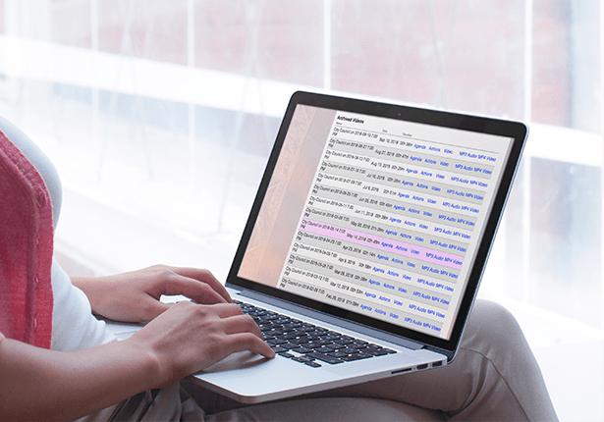
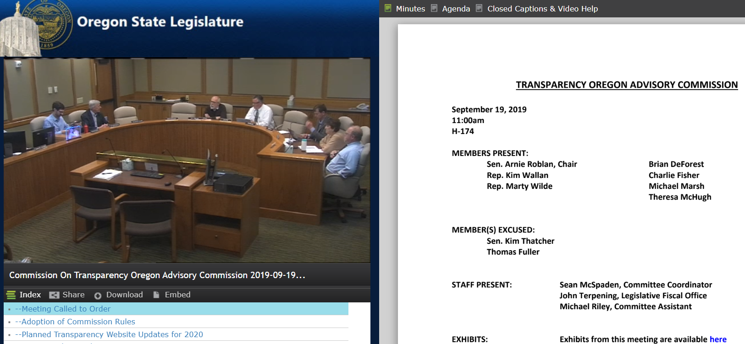
Current Solution
GovMeetings: Streaming & (Live) Indexing
Mobile Responsive
Player
Public Portal
Live and Archived Streaming: 13 Encoders, 1 Portable

Slide 5





Enterprise-grade Hosting, Security, Support
Our #1 priority is you
Content delivery network
90 min RTO & 30 min RPO
99.95% up-time
Failover testing every 2 weeks
Tier III Data Center
DDoS mitigation
CR mgmt. & processes
FedRAMP authorized & ISO 27001 teams
24/7 support
Granicus University
In-app live chat
Customer Success Consultants

Slide 6
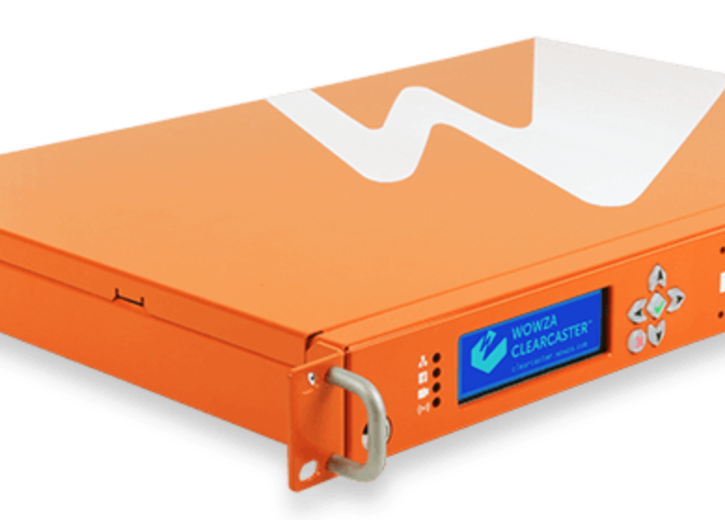
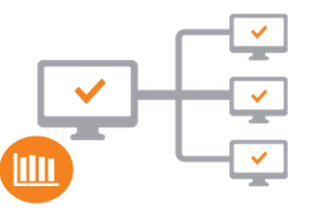

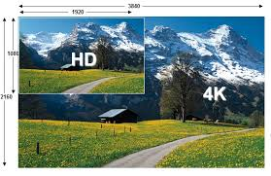

Looking to the Future
Granicus Streaming in 2020
Simplified Workflow & real-time health monitoring
Adaptive Network Encoding
New More Powerful Encoders
Quality Enhancements
Mobile Enhancements

Slide 7


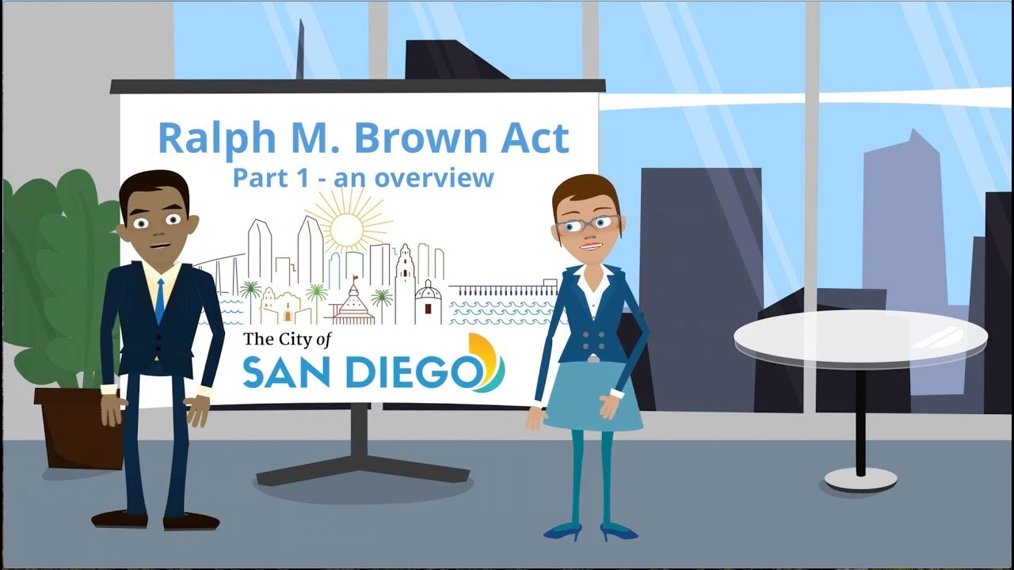


Looking to the Future
Granicus Streaming in 2020
Improved Captioning
Brown Act support
Automated network path speed test ensures you always stream to the optimal ingest point.
Modern interface Enhancements to align with other tools
Improved Reliability

Slide 8
Granicus Customer Support
Contacting Us
Standard Support Hours
9am EST – 9pm EST
Expanded Live Meeting Support Hours:
9am EST – 12am EST
Web (Support.Granicus.com)
Phone
(800) 314-0147
Chat (Expanding to more products, including video)
24/7 System Status available at http://status.granicus.com

Slide 9
Customer Support
Recent Improvements
Phone
Intelligent call routing – get the most knowledgeable rep for your product
Case # > Representative call routing (beta)
Request callback
Portal and Knowledgebase
Relaunch of our customer portal – login to see case history/activity and status (Beta launch end of Aug 2019)
Expanded content on knowledgebase – revamped video training library

Slide 10
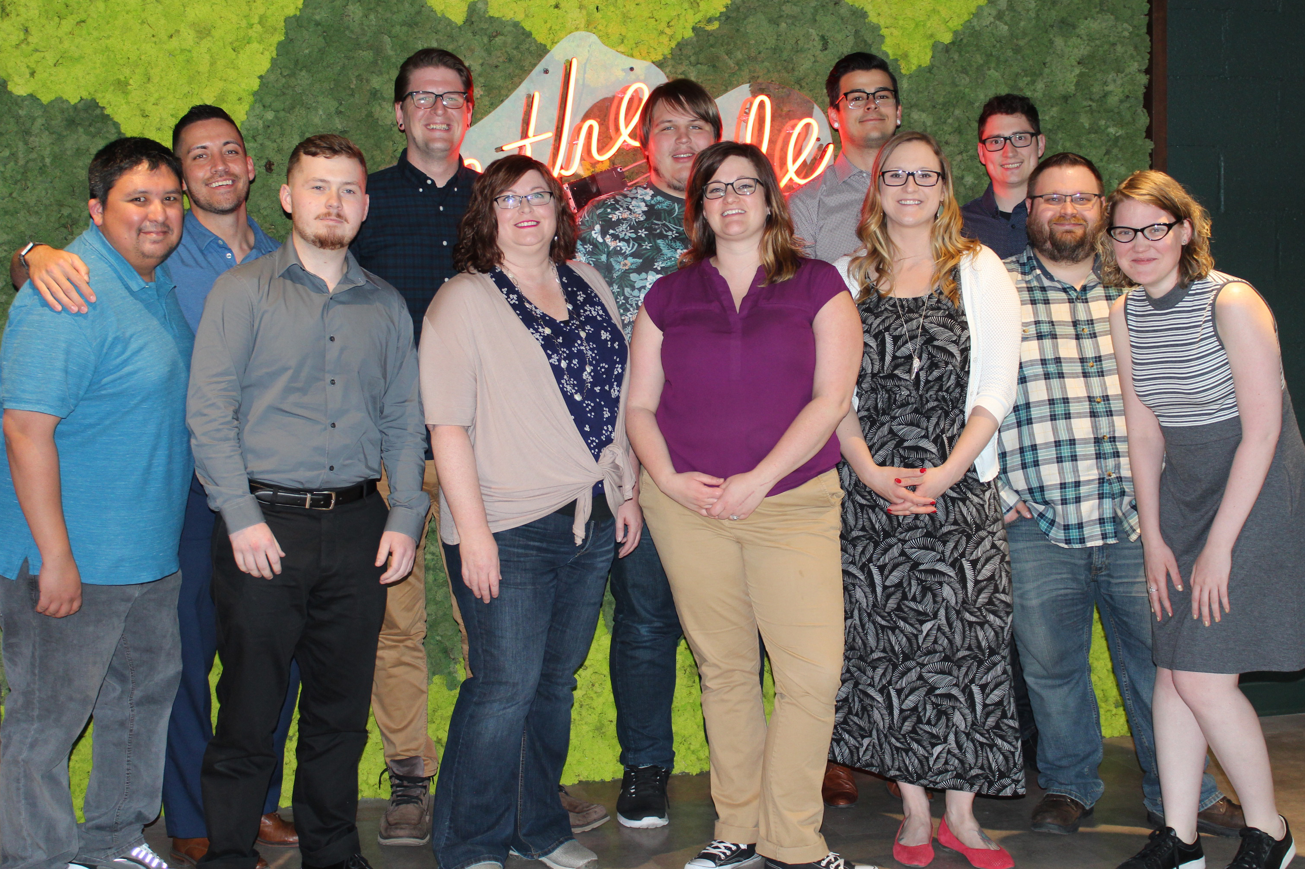
Customer Support
Recent Improvements
Our People
Increased team size by 50% since 2018
Expanded training program , partnered with Wowza Media systems to provide in-depth streaming video training
Team focused on follow up and responsiveness, tracking towards 100% same-day response

Slide 11

Demo
Jesse Wallace| jesse.wallace@granicus.com

Slide 12
Questions?
Erin Pardue| erin.pardue@granicus.com

Slide 13
Thank you
Erin Pardue| erin.pardue@granicus.com

